Slide 1
Is Your Sterilization Room Compliant, Efficient & Safe
Infection Control in Dental Setting

Slide 2
STANDARS
CDC create standards – promotes health by preventing and controlling disease through research and makes recommendations. Their mission is to protect the public
OSHA – ensures safe working conditions for workers by setting and enforcing standards and by providing training outreach, education and assistance.
DENTAL BOARD- created to protect the dental health interest of the public by regulating the dental and dental hygiene professions. Executes sanctions deemed necessary

Slide 3
Where do we start?
Infection prevention and control is a TEAM approach
WE have……an ETHICAL AND LEGAL OBLIGATION

Slide 4
CODE OF ETHICS
INDIVIDUAL AUTONOMY & RESPECT FOR HUMAN BEING
People have the right to be treated with respect
CONFIDENTIALITY
We respect the confidentiality of client information and relationships as a demonstrator of the value we place on individual autonomy
SOCIETAL TRUST
We value client trust and understanding that public trust in our profession is based on our actions and behavior

Slide 5
CODE OF ETHICS
NONMALEFICENCE
We accept our fundamental obligation to provide services in a manner that protect all clients and minimizes harm to them, and others involved in their treatment
BENEFICENCE
We have a primary role in promoting the well-being of individuals and the public be engaging in health promotion/disease prevention activities

Slide 6
CODE OF ETHICS
JUSTICE
We value justice and support the fair and equitable distribution of health care resources. We believe all people should have access to high-quality, affordable oral healthcare.
VERACITY
We accept our obligation to tell the truth and expect that others will do the same. We value self-knowledge and seek truth and honesty in all relationships

Slide 7
Sterilization and disinfection of patient care items
Requires multiple steps using specialized equipment's
Policies and procedures in place for containing, transporting, and handling contaminated instruments and equipment
Follow manufacturer's instruction for reprocessing reusable dental instruments

Slide 8
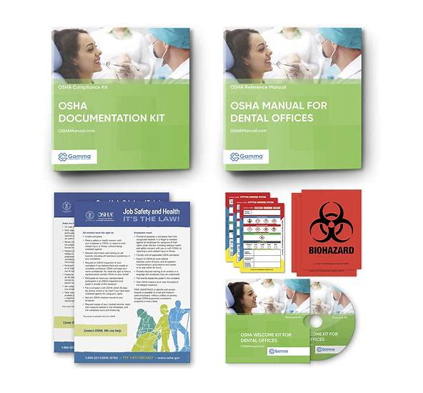
Written standard operating procedures
Reprocessing protocol
Outline of how a spore test error/failure is handles
Team training

Slide 9
Standard Precautions
Standard Precautions integrate and expand the elements of Universal Precautions into a Standard of Care designed to protect healthcare providers from pathogens that can be spread by blood or any other body fluid, excretion, or secretion.
It is not possible to identify those individuals who are infectious, so infection precautions are used for all healthcare personnel and their patients.

Slide 10
Categories of Patient-Care Items
Three categories:
1. Critical.
2. Semi-critical.
3. Noncritical.
Based on intended use and the potential risk of disease transmission

Slide 11
Critical Items
Penetrate soft tissue or contact bone or other normally sterile tissue.
Greatest risk of transmitting infection.
Must be heat sterilized between use, or sterile single-use, disposable devices must be used.
Examples: surgical instruments and periodontal scalers.

Slide 12
Semi-critical Items
Contact mucous membranes or non-intact skin (e.g., exposed skin that is chapped, abraded, or has dermatitis).
Lower risk of transmission.
While high-level disinfection is acceptable, sterilization is recommended and encouraged
Examples: mouth mirrors, amalgam condensers, and reusable impression trays.

Slide 13
Semi-critical Items Special Considerations—Dental Handpieces
Follow manufacturer’s instructions to safely reprocess dental handpieces and accessories (e.g., low-speed motor, reusable prophylaxis angles).
Clean and heat sterilize between patient uses.
Do not subject the handpiece to high-level disinfection and do not simply wipe the surface with a low-level disinfectant

Slide 14
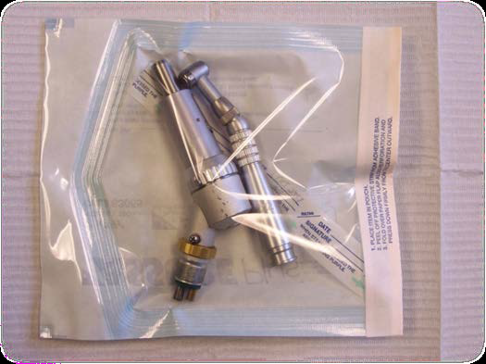
Dental Handpieces
Studies have shown that internal surfaces of these devices may become contaminated
The CDC states that if a motor is connected to air or water, it must be sterilized
Handpieces used in the US MUST be FDA registered and most cheaper versions bought online are not

Slide 15
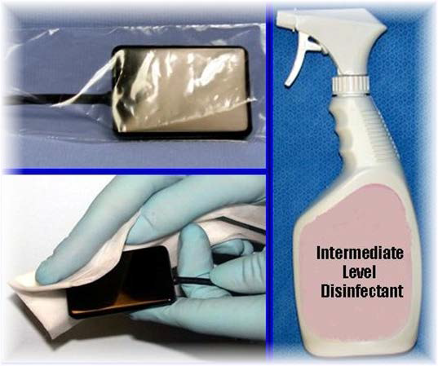
Semi-critical Items Special Considerations—Digital Sensors
Follow manufacturer’s instructions to safely reprocess digital radiography equipment.
Ideally, barrier protection should be used, followed by cleaning and heat sterilization or high-level disinfection between patients.
If the item cannot tolerate these procedures, then at minimum, barrier protection should be used, followed by cleaning and disinfection with an intermediate-level disinfectant between patients.

Slide 16
Non-critical Items
Contact intact skin.
Barrier protect or clean and disinfect (if visibly soiled) using a low to intermediate-level (i.e., tuberculocidal) disinfectant.
Examples: x-ray head or cone, facebows, blood pressure cuff.

Slide 17
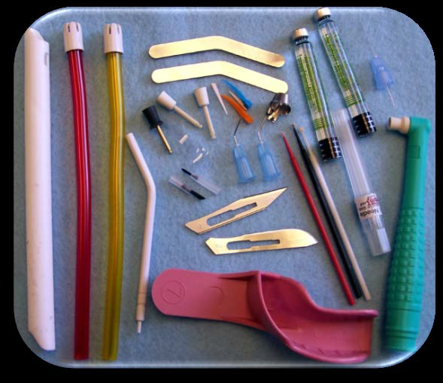
Single-Use (Disposable) Devices
Intended for use on one patient during a single procedure.
Usually not heat-tolerant.
Cannot be reliably cleaned.
Do NOT reprocess.
Examples: syringe needles, prophylaxis cups, and plastic
orthodontic brackets.

Slide 18
Preventing sterilization disasters
Following CDC protocols for instrument processing is necessary to prevent this from happening in your office.
Do not use non-sterile instruments to the patient treatment procedure.

Slide 19
Instrument processing is not just about safety
The “Good Enough” mentality for instrument processing
Inefficient instrument processing is a bottleneck to productivity and profitability
Having sterile instruments ready for scheduled procedures is critical
Instrument processing is essential to safe practice
It’s also a key to a productive practice

Slide 20
Think of your sterilization area
Would you show your sterilization area to a patients?
Would you show your sterilization area to a potential employees?
What do assistant think about working in the sterilization area?

Slide 21
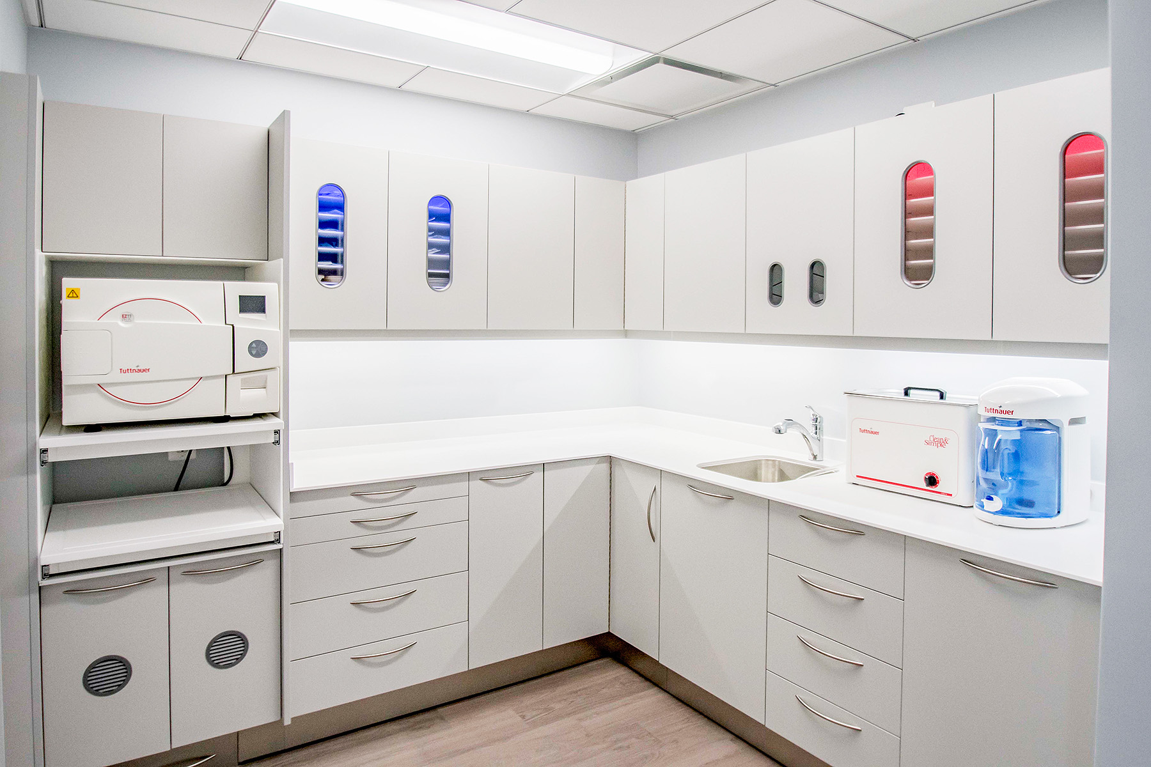
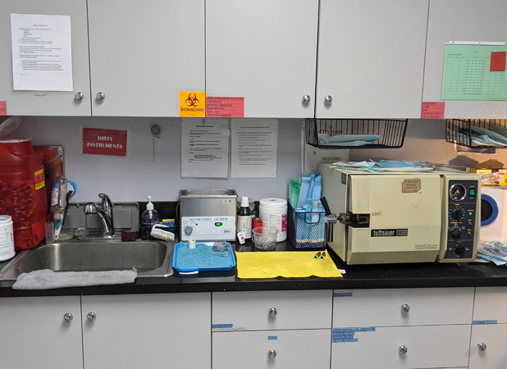
your sterilization area

Slide 22
Dental practice reality
Assistant in and out of sterilization area 80-100 times per day
Studies show 75% of sterilization areas are inadequate
30-50% of sharps injuries occurs during instrument processing
Instrument processing is at least 25% of all labors cost

Slide 23
Instrument-Processing Area
The ideal instrument-processing area:
  Should be dedicated only to instrument processing
  Should be physically separated from the operatories and dental laboratory
  Should not be a part of a common walkway

Slide 24
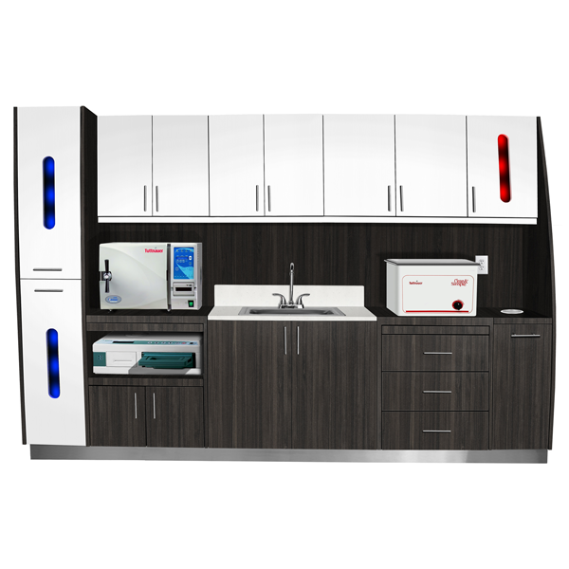
Design and organization
Follows CDC guidelines
Configures for the work and the space
Withstands the harsh instrument processing environment
Constructed of easily cleaned materials
Organized for efficiency

Slide 25
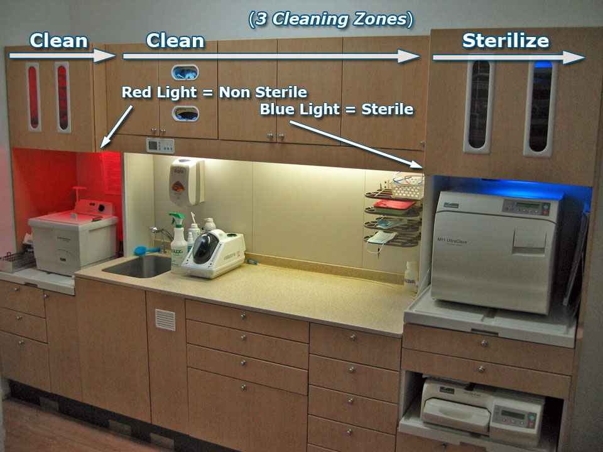
Proper workflow
Receiving, Cleaning, and Decontamination
Preparation and Packaging
Sterilization
Monitoring/Sterility Assurance
Storage

Slide 26
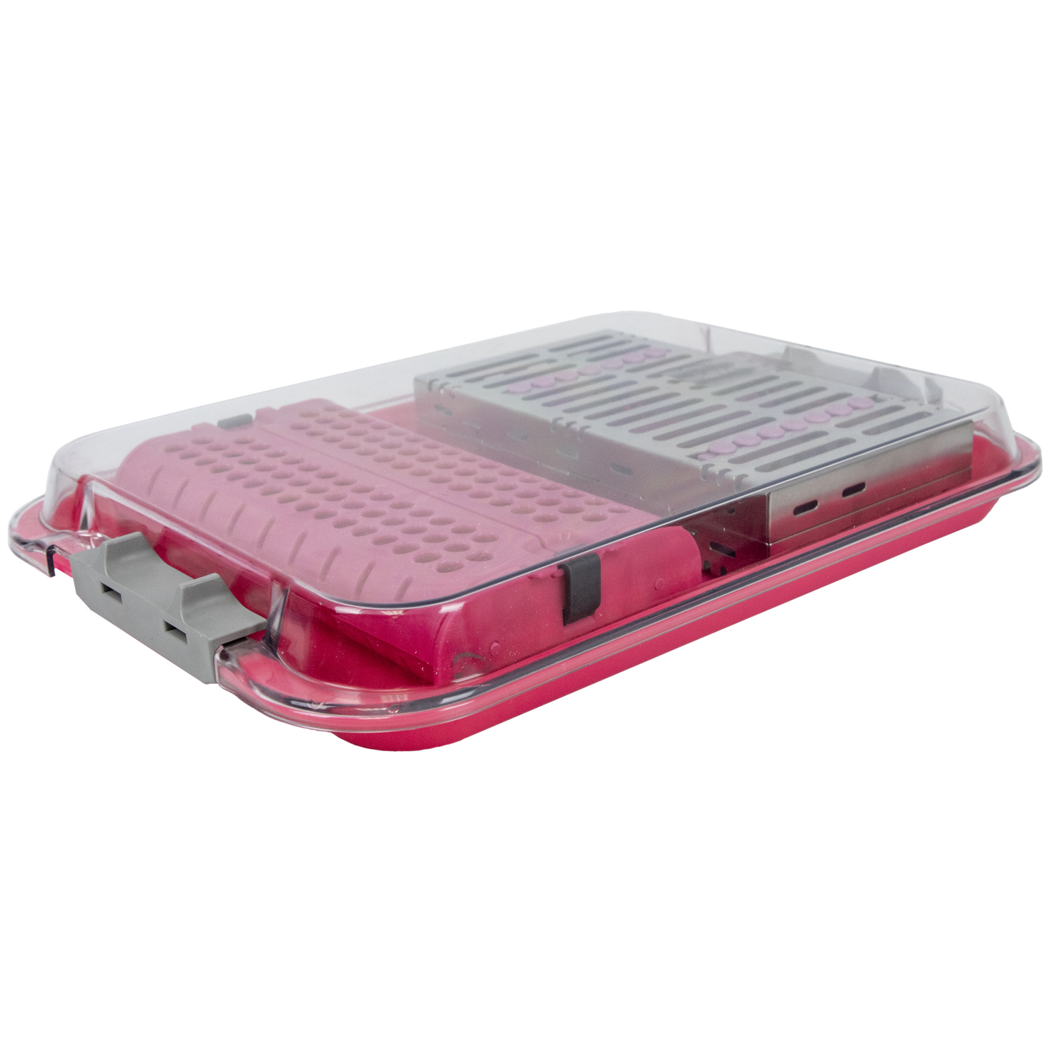
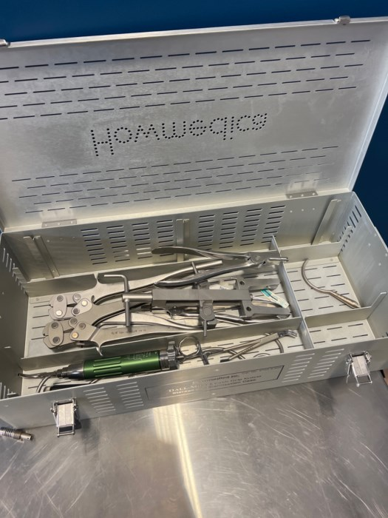
Receiving, Cleaning, and Decontamination
Place instruments in a coved container to transport
Wear puncture-resistant gloves, facemask, eye protection, and gown
Dirty instruments are received, sorted, and cleaned in one area
Clean, rinse and inspect

Slide 27
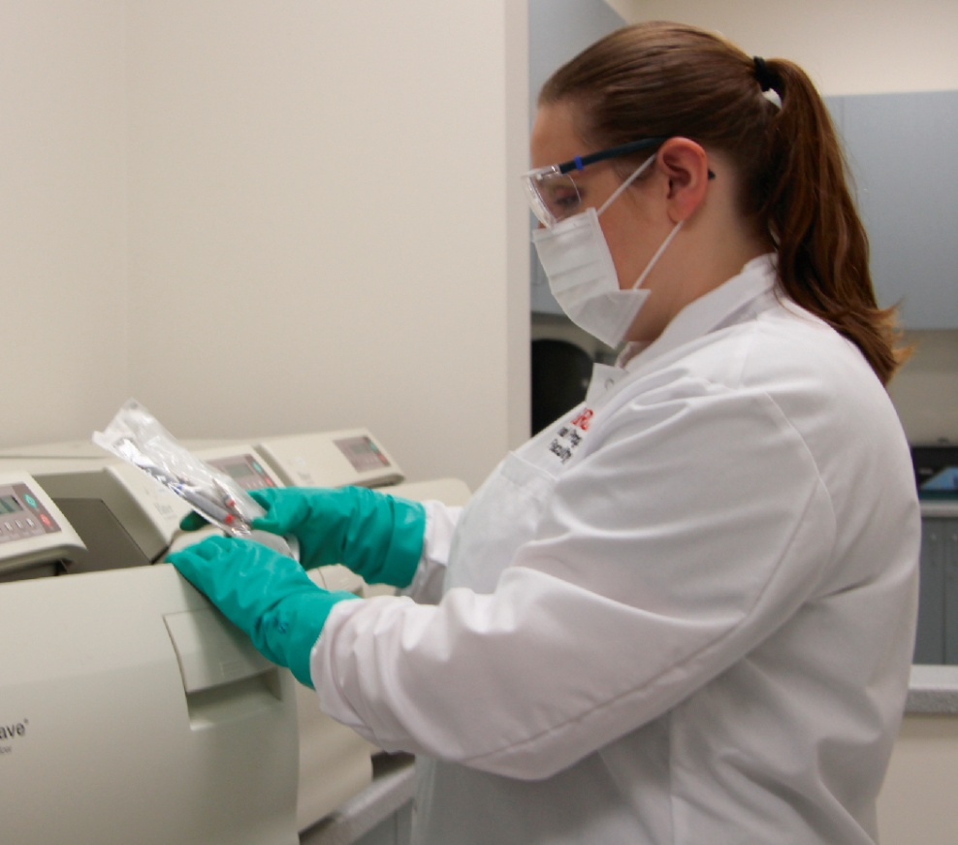
Personal Protective Equipment when Processing Instruments
To prevent disease agents from a previous patient from being transferred to you, another dental team member, or the next patient, instrument processing must be performed in a consistent and disciplined manner.
You must always use personal protective equipment (PPE), including utility gloves, mask, eyewear, and protective clothing, when processing instruments.

Slide 28
Cleaning
Cleaning should always occur before disinfection or sterilization.
– Presence of soil can compromise the disinfection or sterilization process.
Automated or manual.
Minimize exposure potential.
Use carrying containers to transport contaminated instruments.
Wear personal protective equipment (e.g., heavy duty utility gloves, mask, protective eyewear and clothing).

Slide 29
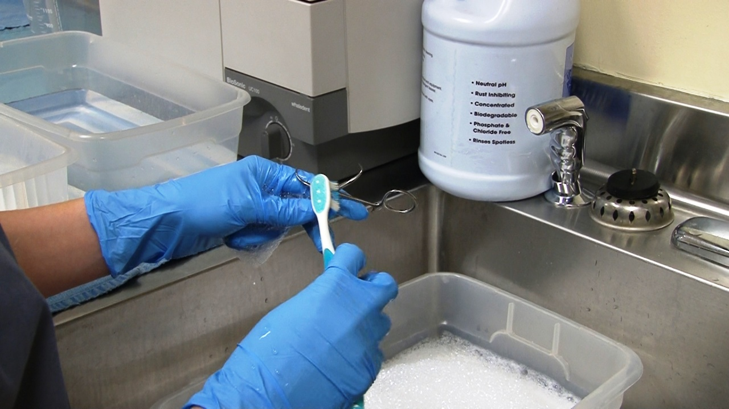
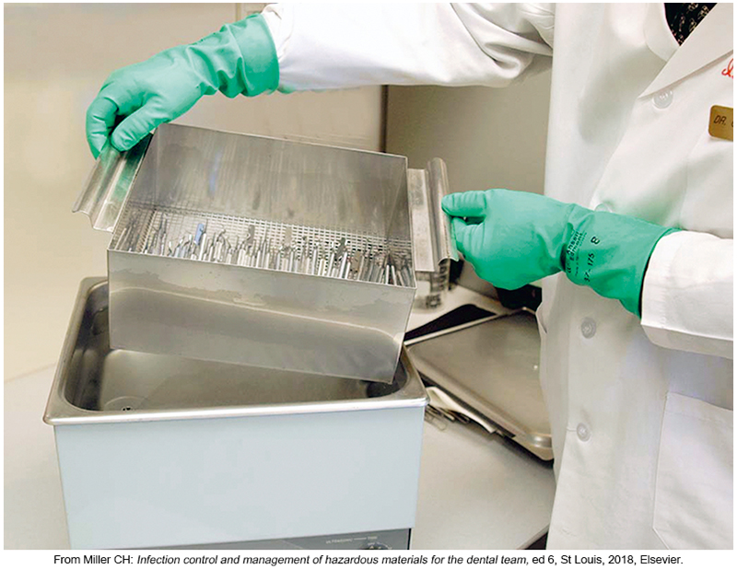
Pre-cleaning and Packaging Instruments
Instruments may be precleaned in one of three ways:
  Hand scrubbing - is the least desirable method of cleaning instruments because it requires direct hand contact with the contaminated instrument.
  Ultrasonic cleaning -Ultrasonic cleaners are used to loosen and remove debris from instruments.
  Instrument-washing machine

Slide 30
Preparation and Packaging
Wrap, package, or place instruments in containers before heat sterilization.
– Instruments should be thoroughly dry before they are packaged, wrapped, or otherwise contained.
Follow manufacturer’s instructions.
For example: open hinged instruments, disassemble instruments if required, and ensure that packaging materials are compatible with the method of heat sterilization being used.

Slide 31
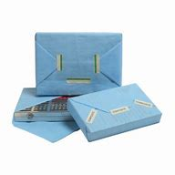
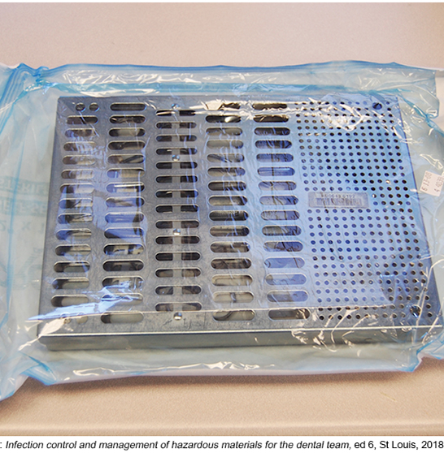
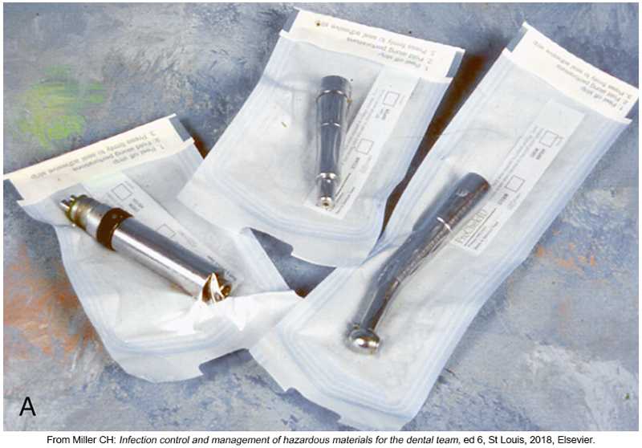
Instrument Packaging

Slide 32
Methods of Sterilization
Sterilization destroys all microbial forms, including bacterial spores. Sterile is an absolute term; there is no “partially sterile” or “almost sterile.”
All reusable items (critical and semi critical instruments) that come into contact with the patient’s blood, saliva, or mucous membranes must be heat sterilized.

Slide 33
sterilization
The three most common forms of heat sterilization in the dental office are:
  Steam
  Chemical vapor
  Dry heat

Slide 34
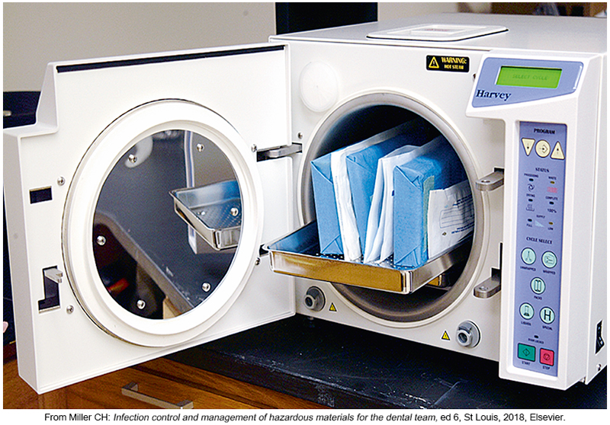
Steam sterilization
Steam is most widely used method
Utility gloves are suggested
Follow manufacturer suggestion
Arrange items to permit free circulation of steam and to dry
Allow packages to dry in sterilizer to avoid contamination

Slide 35
Steam sterilizer types and classes
DYNAMIC AIR REMOVAL
Pre/Post Vacuum (Class B) chamber residual air is removed by vacuum before and after sterilization
Steam Flush Pressure Pulse (SFPP) – chamber residual air is removed be repeated steam flushes and above-atmospheric-pressure pulses. Newest technology
GRAVITY DISPLACEMENT
Chamber residual air is gradually displaced by incoming steam

Slide 36
Paper up or paper down
Most experts agree that pouches should be either stood on edge or place side down
Always follow your machine’s instructions for use

Slide 37
Sterilization Monitoring:
Types of Indicators
Mechanical: Measures time, temperature, and pressure.
Chemical: Change in color when physical parameter is reached.
Biological (spore tests):
- Uses biological spores to assess the sterilization process directly.
Indicators are specific to the type of sterilization used.

Slide 38
Record Keeping
Sterilization monitoring (e.g., biological, mechanical, chemical) and equipment maintenance records are important components of a dental infection prevention program.
Ensures cycle parameters have been met and establishes accountability.
If there is a problem with a sterilizer, documentation helps to determine if an instrument recall is necessary.

Slide 39
A positive spore test means failure
If you have a failed test, do not recall items because a single positive spore test does not mean the sterilizer is defective
Shut the machine down and immediately retest
Do not use until it passes a second test!
Have adequate “back-up” sterilization capacity!
If the device fails a second time, recall and reprocess all items from that sterilizer
Begin using the back-up sterilizer until the primary sterilizer is repaired and passes successfully

Slide 40
Storage of Sterile and Clean Items and Supplies
Store clean items in dry, closed, or covered cabinet.
Use date- or event-related shelf-life practices.
Examine wrapped items carefully before use.
When packaging of sterile items is damaged, clean, repackage, and heat sterilize again

Slide 41
Environmental Surfaces
A surface or equipment that does not contact patients directly.
Can become contaminated through touch, splash, or droplets generated during patient care.
Can serve as reservoirs of microbial contamination.
Written policies and procedures must be in place for routine cleaning and disinfection of environmental surfaces

Slide 42
Environmental Surfaces
Emphasis for cleaning and disinfection should be placed on surfaces that are most likely to become contaminated
Always carefully follow the manufacturers “instruction for use” for the disinfectant you are using

Slide 43
Categories of Environmental Surfaces
Clinical contact surfaces:
High potential for direct contamination from spray or spatter or by contact with gloved hands of dental health care personnel (DHCP).
Emphasis for cleaning and disinfection should be placed on these surfaces.
Examples: light handles, bracket trays, switches on dental units, computer equipment.

Slide 44
Cleaning Clinical Contact Surfaces
Risk of transmitting infections greater than for housekeeping surfaces
Barrier protect and change between patients
OR
Clean followed by disinfection with an EPA-registered low-level (HIV/HBV claim) to intermediate-level (tuberculocidal claim) hospital disinfectant.

Slide 45
Categories of Environmental Surfaces
Housekeeping surfaces:
Do not come into direct contact with patients or devices.
Routinely clean with soap and water or an EPA registered detergent/disinfectant
If a housekeeping surface becomes visibly contaminated, disinfect using an EPA registered intermediate level disinfectant
Carpeted flooring and fabric-upholstered furnishing should not be used in treatment rooms, laboratories or instrument processing areas

Slide 46
General Cleaning Recommendations
Use personal protective equipment (e.g., heavy-duty utility gloves, masks, protective eyewear).
Cleaning should always come before disinfection.
Follow manufacturer’s instructions for proper use of hospital disinfectants registered by the
US Environmental Protection Agency (EPA).–EPA-registered disinfectants
Do not use liquid chemical sterilant or high-level disinfectants.

Slide 47
Control of Chemical Spills
Accidents and spills should not be common occurrences
Planning and practice in dealing with such spills should minimize employee exposure to harmful chemicals
Refer to the safety data sheet (SDS) for the specific product for accurate information on how to manage spills

Slide 48
Mercury Spill Kit
Should be available in all dental offices in which amalgam is used
Exposure to even small amounts of mercury is very hazardous to the health of dental personnel
Mercury can be absorbed through the skin or through the inhalation of mercury vapors

Slide 49
Disposal of Empty Containers
Empty containers may hold residues that can burn or explode
Never fill an empty container with another substance because a dangerous chemical reaction could occur
Follow the label and the SDS for guidance in disposing of empty containers

Slide 50

Thank you !!!

